Slide 1
Fire Doors
Do You See
What I See?
3/2019

Slide 2
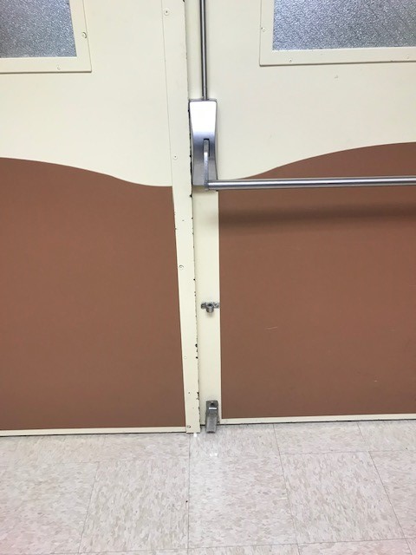
Wired glass has been replaced with a pane of non-wired, non-rated, rippled glass
Missing tags, screws and hardware, won’t stay latched at floor
Nothing identified on fire door inspection

Slide 3
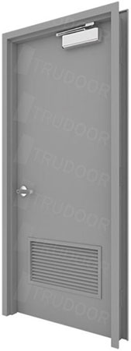

We have even seen a metal door with louvers that ‘passed’ a fire door inspection

Slide 4
Why is it important to follow a barrier from outside wall to outside wall?

Slide 5
Why is it important to have Life Safety drawings, blueprints or a code footprint?
If the facility doesn’t know what they have how can the structure be maintained correctly? How can you survey the building correctly and determine an acceptable POC?
Construction Type? (A fix with wood in a Type II)
Hour ratings? (Built/maintained to UL design)
Ceiling rating? (Ceiling tiles/return air grids)
Firewall or smoke wall? (Caulk ratings)
Fire doors or smoke doors? (Placard/latch/direction of travel)

Slide 6
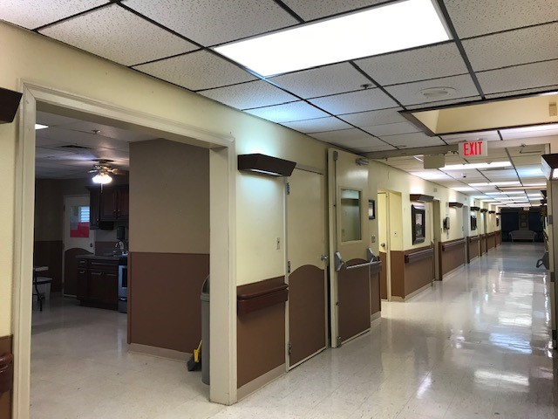
Two hour firewall
Continues to outside wall with another door to an office
Office door in firewall is not positive latching, no self-closure, no label, and missed during the facility’s fire door inspection

